Slide 1


DON BOSCO INSTITUTE OF TECHNOLOGY
Department of Information Science and Engineering
SEMINAR PROJECT IMPLEMENTATION
ON PARTS OF SPEECH TAGGING FOR DATA PREPROCESSING USING NATURAL LANGUAGE PROCESSING
Submitted by:- Under the Guidance of:- Umme Athiya Assist. Prof Chaithra A S 1DB16IS051 Dept. ISE , DBIT

Slide 2
Contents
Introduction.
Problem Definition.
Objectives.
Use Case.
Hardware & Software Requirements
Design Phase.
Implementation.
Results.
Conclusion.
References.

Slide 3
Introduction
Natural language processing (NLP) is a subfield of :-
Linguistics & Artificial Intelligence.
Machine Learning is the scientific study of Statistical Models & Algorithms.
Parts of Speech Tagging is also called as Word Category Disambiguation.
It is also used to reduce a word to its root form.

Slide 4
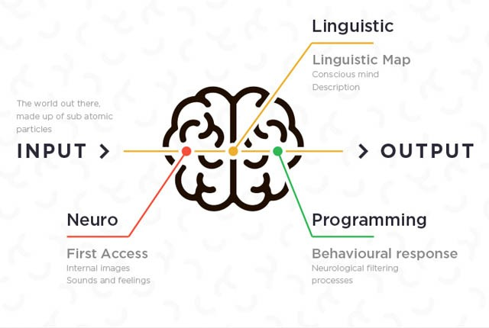

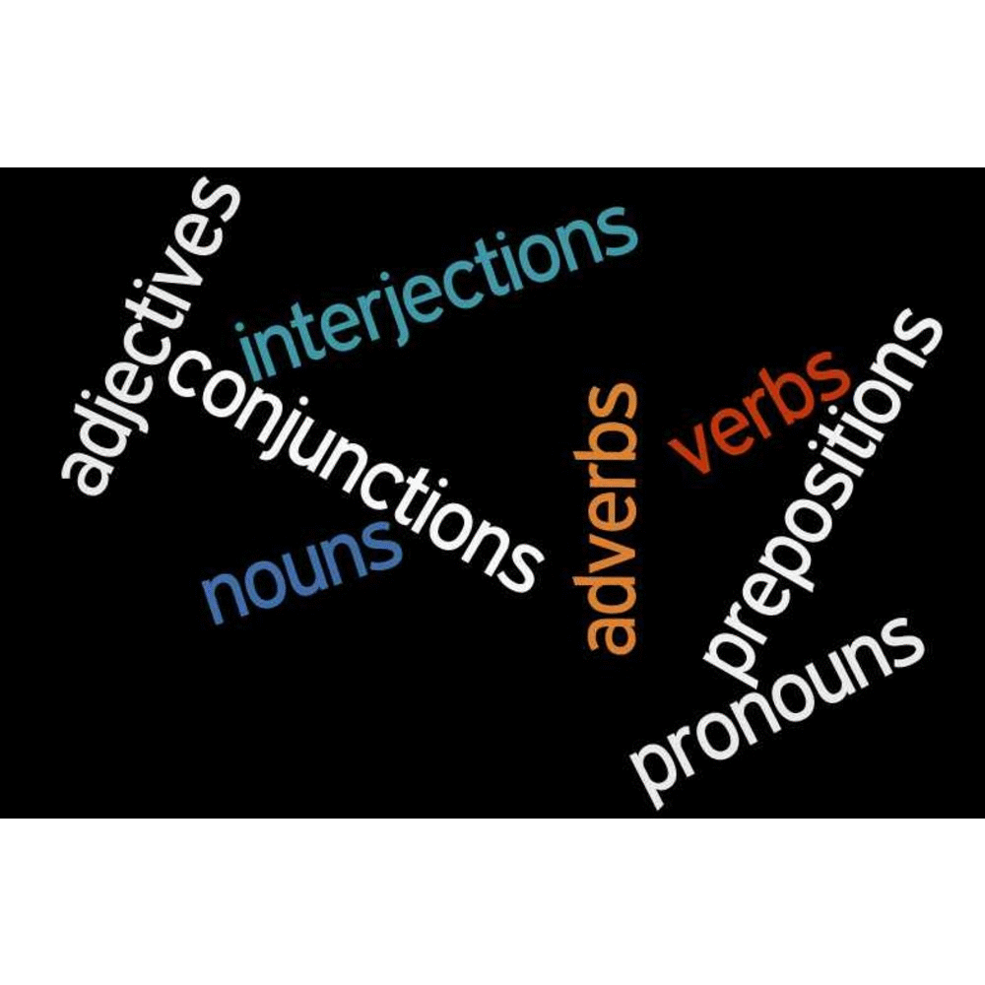
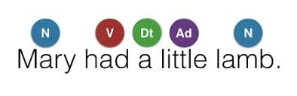
N – Noun
V – Verb
Ad – Adverb
Dt - Determiners

Slide 5
Problem Definition
POS Tagging is an extremely important topic in statistical NLP.
Before beginning any sophisticated processing on text, it is important to know
the categories of the words that form the text.
These tags then become useful for higher-level applications.

Slide 6
Objectives
Accurate POS tagging used in Web Queries.
It is used in Speech Synthesis.
Parsing:- Need to know if word is a Noun or a Verb.
Information Extraction:- Finding names, relations etc.
Fig 1:-Block Diagram for Parts of Speech Tagging
Raw Text
Sentence Segmentation
Tokenization
Ambiguity Resolution
Parts of Speech Tagging

Slide 7
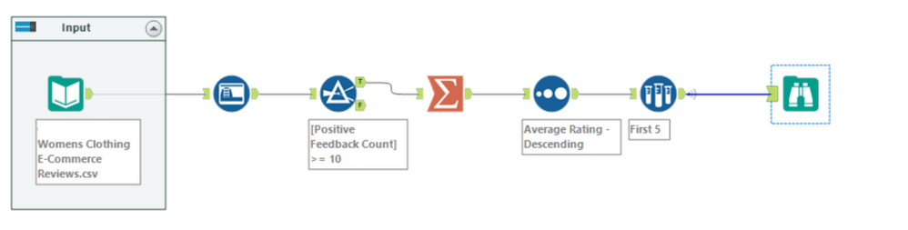
Use Case
Women’s Clothing E-Commerce Reviews.
Its nine supportive features offer a great environment to parse out the text through its multiple dimensions.
Fig 2:- USE CASE DIAGRAM

Slide 8
Hardware & Software Requirements
Hardware Requirement:-
Processor – Intel or AMD (Advance Micro Devices)
RAM – 512 MB (Minimum)
Hard Disk – 1 MB(Minimum)
b) Software Requirement:-
Backend Tools: - HTML, CSS, Jupyter Notebook (python).
Frontend Tool: - Flask (mainframe API).

Slide 9
Design Phase
Prediction
Data Visualization
Giving insights from model results
Model Building
Gathering Data
Cleaning Data
Fig 3:- Building Model

Slide 10
Design Phase
a) Existing System:-
Ambiguity problem.
The issue of input data segmentation into linguistic units.
b) Proposed System:-
Ambiguity can potentially be reduced.
Avoids errors due to incorrect categorization of rare sense.
c) Advantages:-
Information Retrieval.
Text to Speech.
Word Sense Disambiguation.

Slide 11
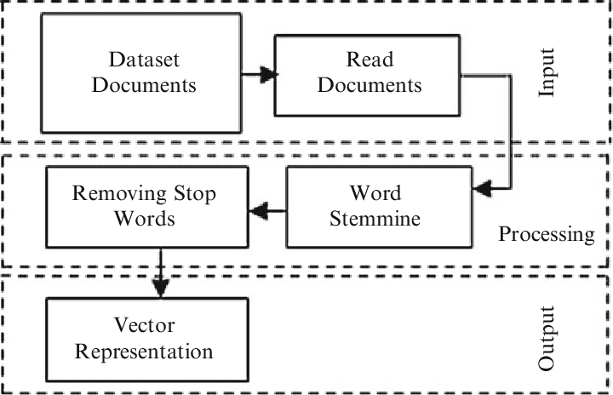

Implementation
Document Preprocessing:-
Tokenization
Lemmatization
Removal of Stop Word
Fig 4:- Document Preprocessing Block Diagram Fig 5:- Preprocessing

Slide 12
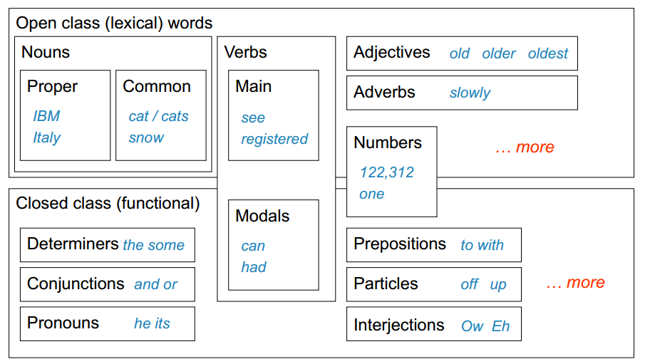
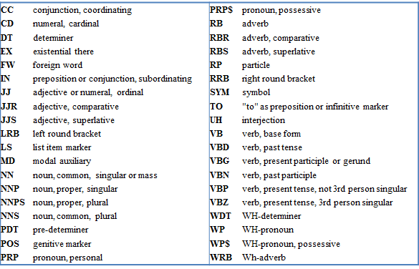
Implementation
Categories of POS:-
a) Open Classes:-
Nouns, Verbs, Adjectives and Adverbs.
b) Closed Classes:-
These have a fixed membership words – determiners, pronouns, prepositions.
Fig 6:- Categories of POS Fig 7:- POS Notations

Slide 13
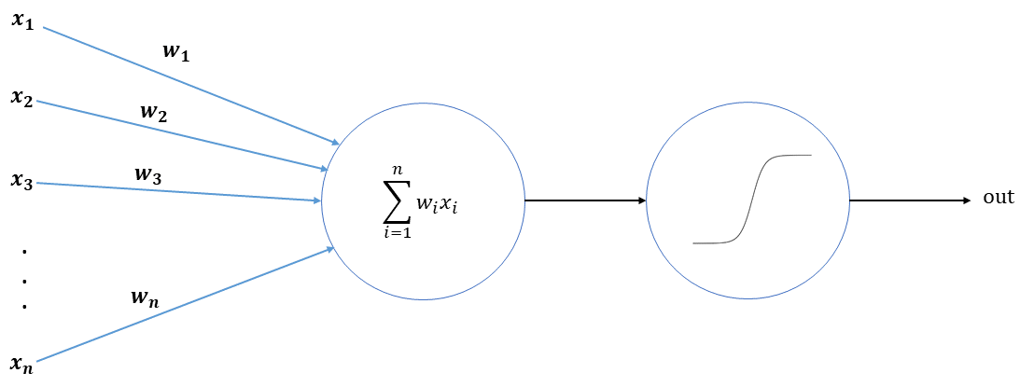
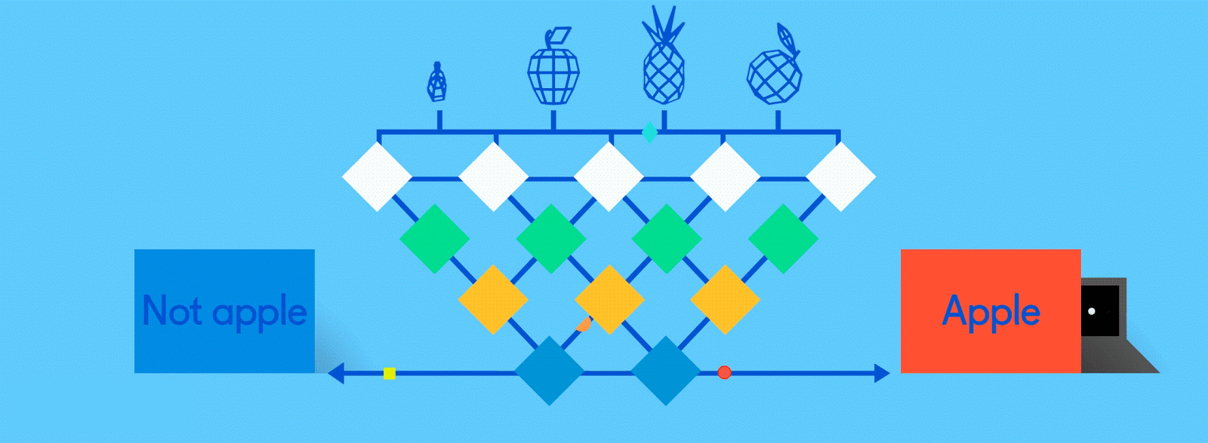
Implementation
Logistic Regression:-
It is a statistical model that in its basic form uses logistic function.
It is used to model a binary dependent variable.
It is a classification technique.
Fig 8:- Sigmoid Function - Logistic Regression Fig 9: Example

Slide 14
Results
Evaluation of Results:-
SL NO | Classification Algorithms | Accuracy | Confusion Matrix | Precision 0 1 |  | f1- score 0 1 |  | Recall 0 1
1. | Decision Tree | 80.88% | [ 374 447] [ 451 3426] | 0.45 | 0.88 | 0.45 | 0.88 | 0.46 | 0.88
2. | Multinomial NB | 85.591% | [ 65 149] [ 11 3240] | 0.86 | 0.96 | 0.45 | 0.98 | 0.30 | 1.00
3. | Logistic Regression | 89.342% | [ 991 616] [ 385 7403] | 0.72 | 0.92 | 0.66 | 0.94 | 0.62 | 0.95
Fig 10:- Various Algorithms result table

Slide 15
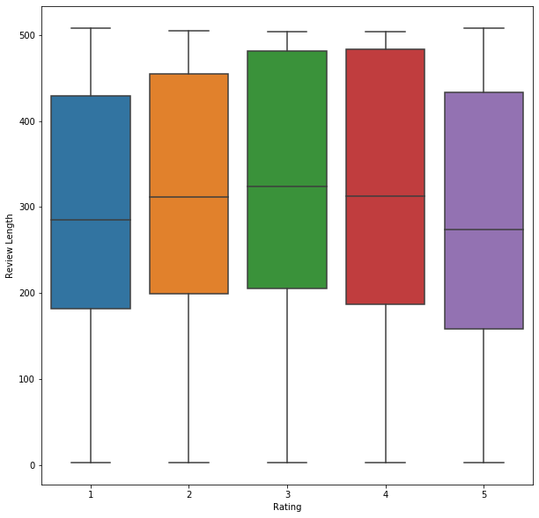
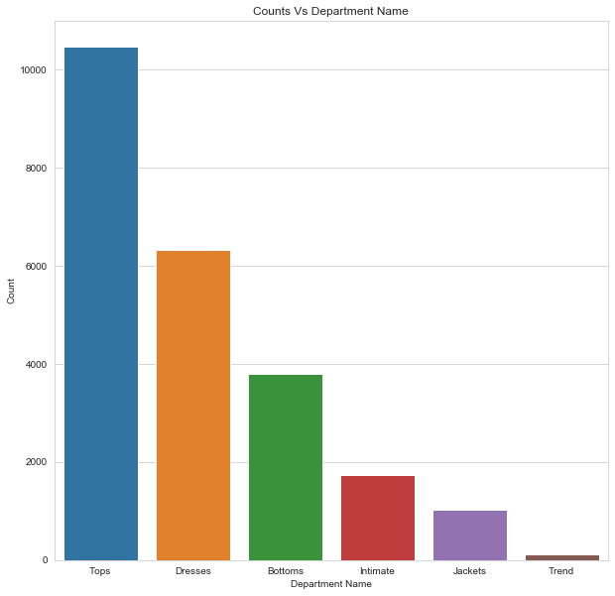
Results
Fig 11: Candlestick Graph Fig 12: Bar Graph

Slide 16
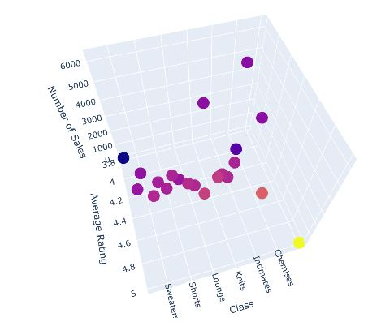
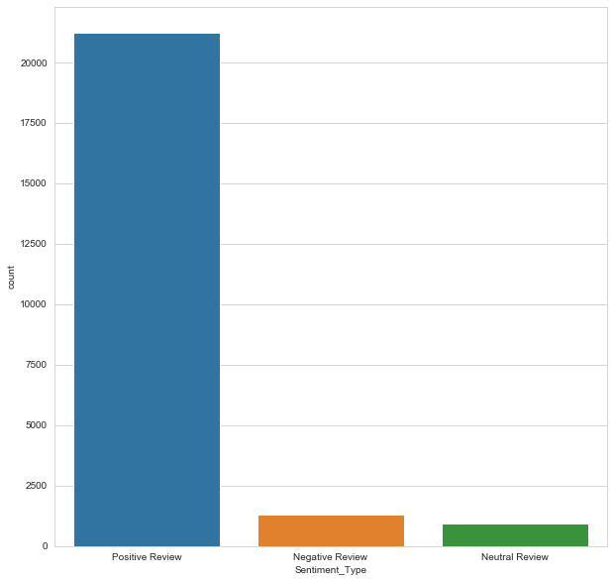
Results
Fig 13: Scatter Plot Graph Fig 14: Bar Graph(Reviews)

Slide 17
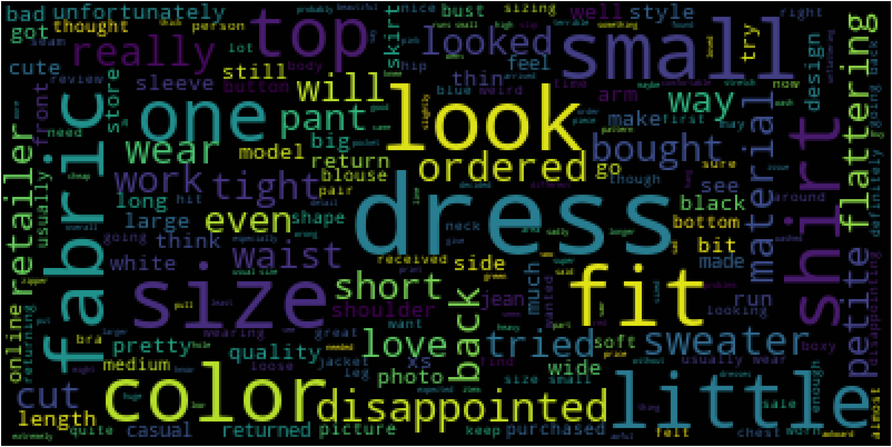
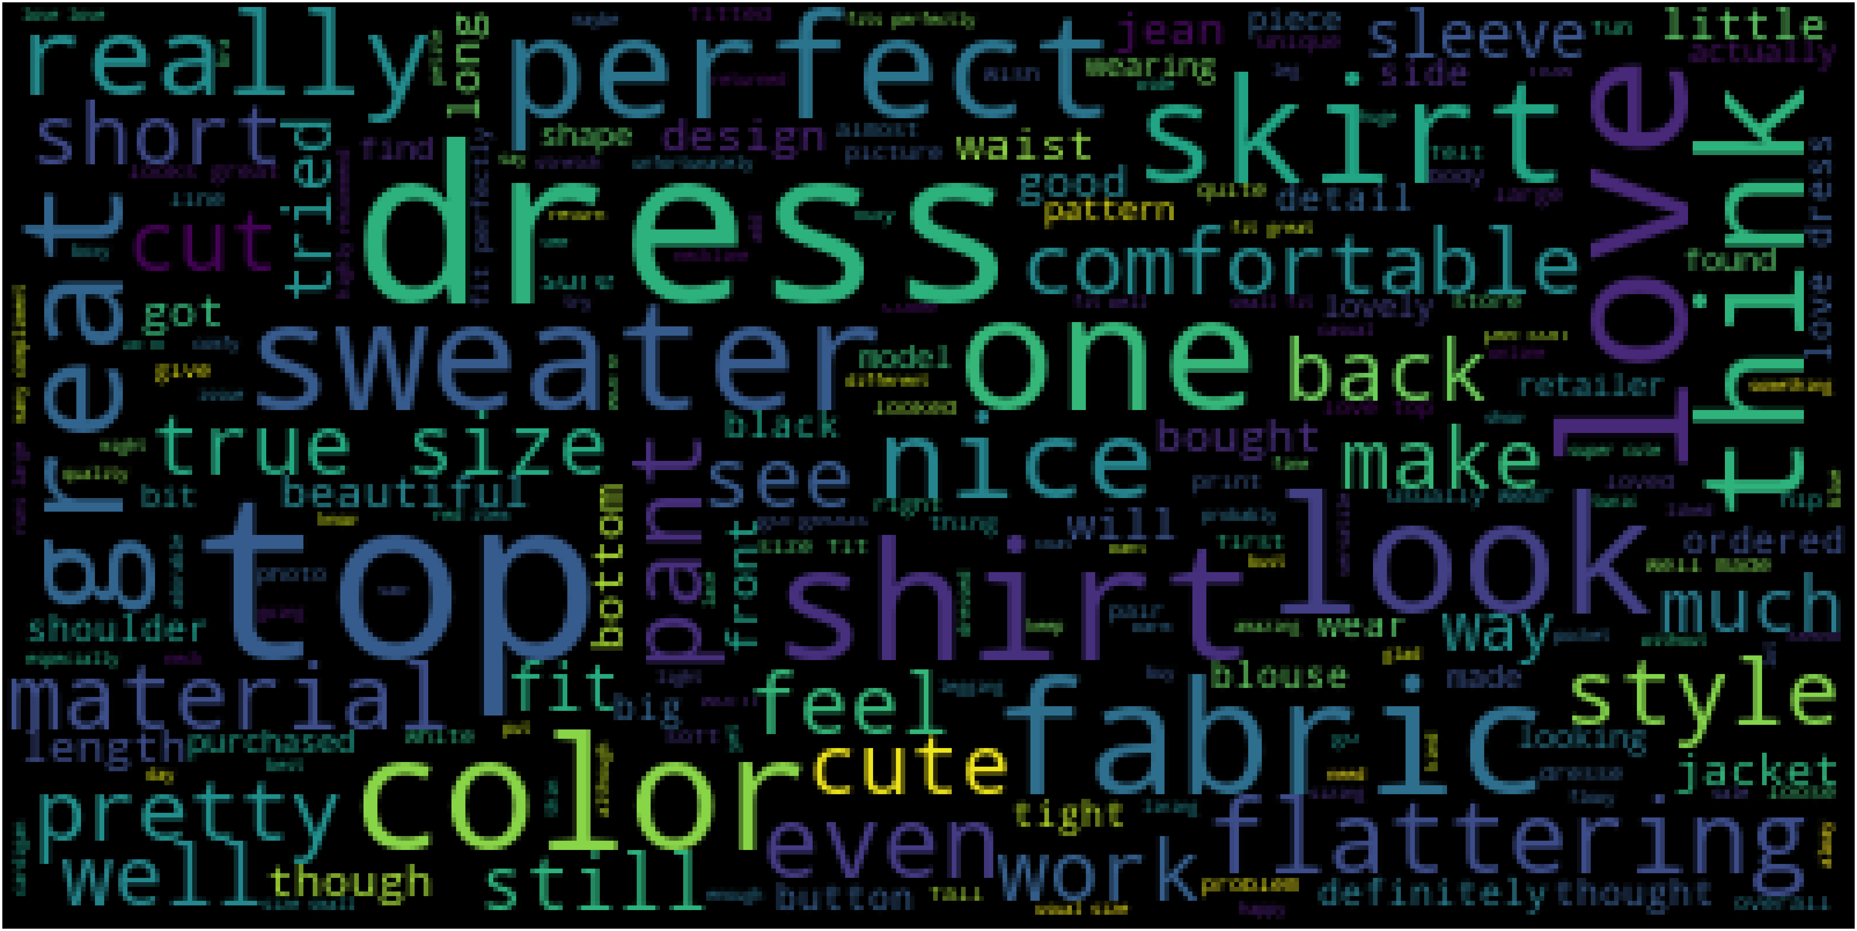
Results
Fig 15: Negative Reviews Fig 16: Positive Reviews

Slide 18
Conclusion
POS tagging as an application of SNLP.
Used in HMMs, TBL.
Statistical Taggers:-
Good results for positional language(English)
Relatively cheap to build.
Over fitting avoidance needed

Slide 19
References
[1] IEEE Paper - Part-of-speech tagging based on dictionary and statistical machine learning 2016 35th Chinese Control Conference by Zhonglin Ye, Zhen Jia, Junfu Huang, Hongfeng Yin.
[2]POS Tagger Tokenizer by Saeed Rahmani, Mostafa Fakhra Ahmed published in 2015, 2nd International Conference on Knowledge based Engineering.

Slide 20
THANK YOU

